Slide 1
Today’s Agenda
Boolean logic
Logic gates operations and their applications.

Slide 2
Boolean Logic
Boolean logic deals with Boolean variables and logical operations.
Boolean variables can take two discrete values (0,1).
Logical operations:
AND: z=x.y
OR : z=x + y
NOT: z= x’

Slide 3
Truth Tables of Logic Operations
AND:
OR:
X | Y | Z
0 | 0 | 0
0 | 1 | 0
1 | 0 | 0
1 | 1 | 1
X | Y | Z
0 | 0 | 0
0 | 1 | 1
1 | 0 | 1
1 | 1 | 1
NOT:
X | Z
0 | 1
1 | 0

Slide 4
Logic Gates
Basic Building Blocks
Logic Gate Symbol
Unique Function
Truth or Function Table
Function Expression
Timing Diagram

Slide 5

AND Gate
1 output
2 inputs
3 inputs
4 inputs
Multiple inputs

Slide 6

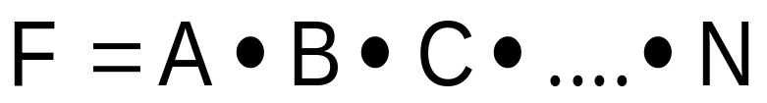
AND Gate function
Logical Multiplication function
Input |  | Output
A | B | F
0 | 0 | 0
0 | 1 | 0
1 | 0 | 0
1 | 1 | 1

Slide 7
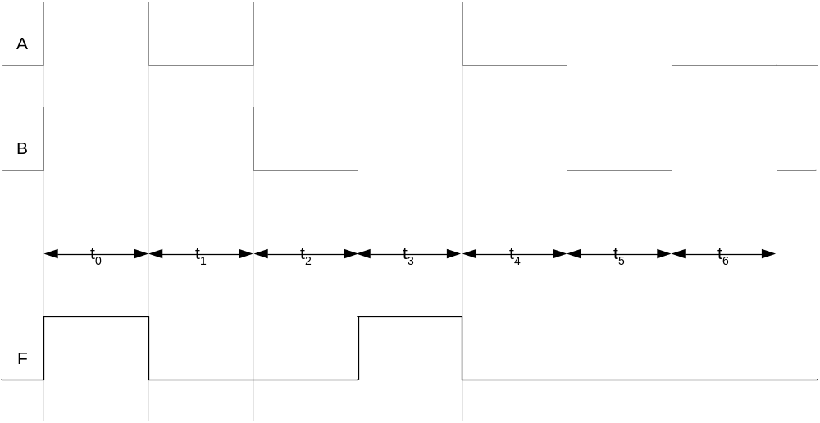
AND Gate Timing Diagram

Slide 8
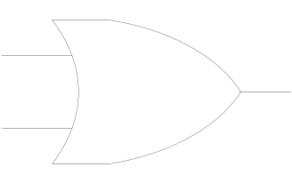
OR Gate
1 output
2 inputs
3 inputs
4 inputs
Multiple inputs

Slide 9

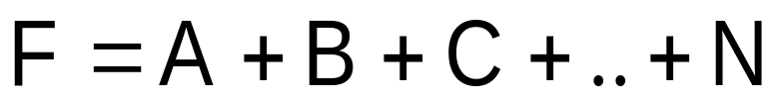
OR Gate function
Boolean Add function
Input |  | Output
A | B | F
0 | 0 | 0
0 | 1 | 1
1 | 0 | 1
1 | 1 | 1

Slide 10
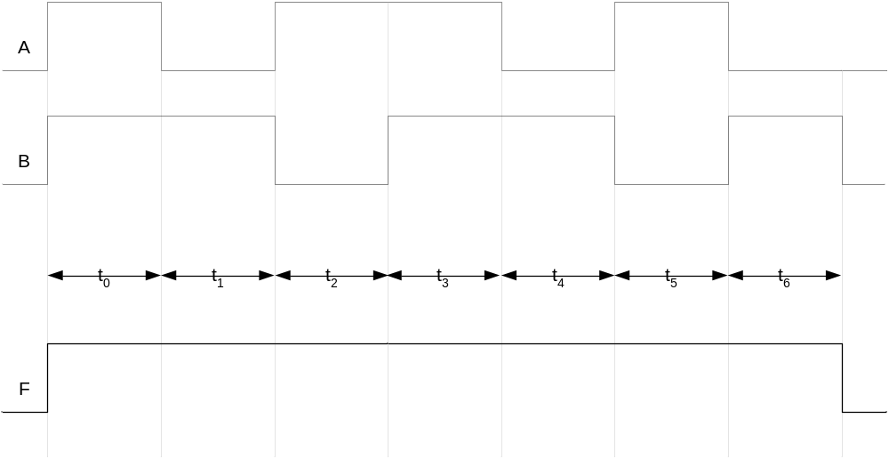
OR Gate Timing Diagram

Slide 11
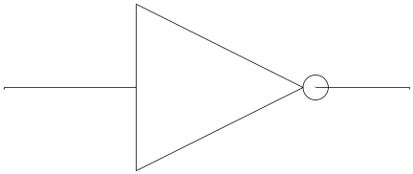
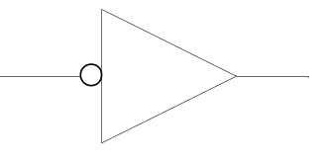
NOT Gate
1 input
1 output

Slide 12
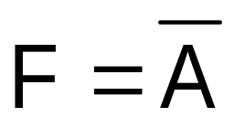
NOT Gate function
Invert function
Input | Output
A | F
0 | 1
1 | 0

Slide 13
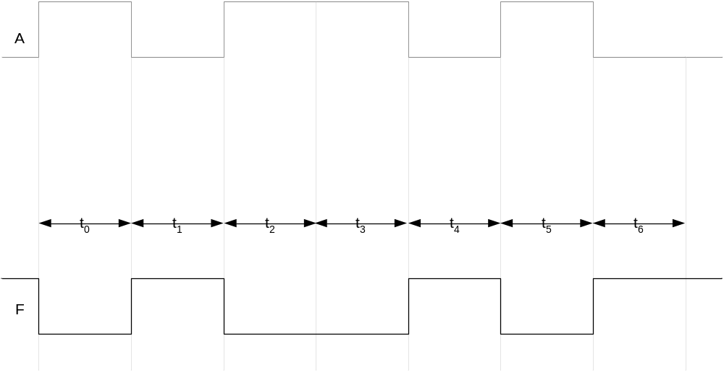
NOT Gate Timing Diagram

Slide 14
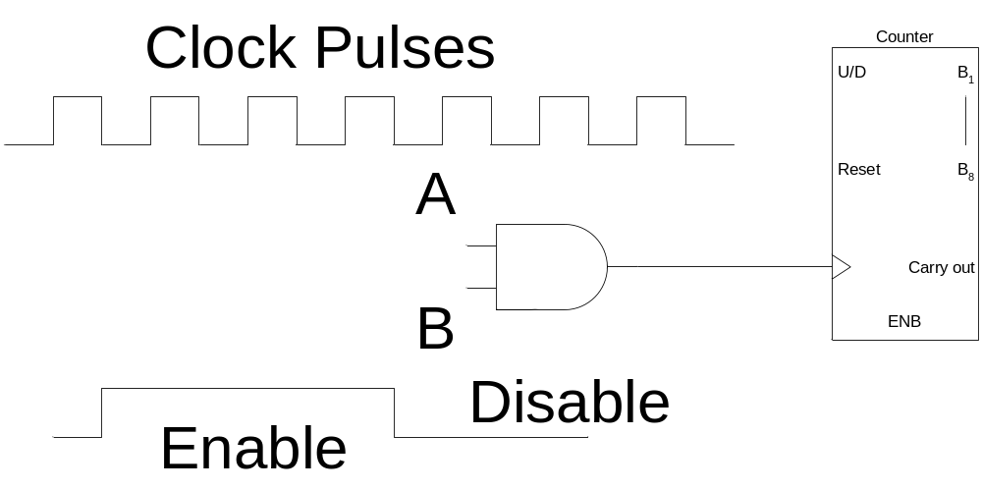
AND Gate Applications
Enable/Disable Device
  Counter counts when it receives pulses

Slide 15
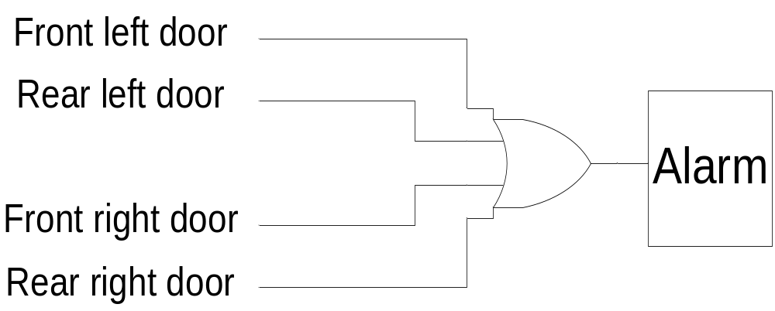
OR Gate Applications
Car door open alarm

Slide 16
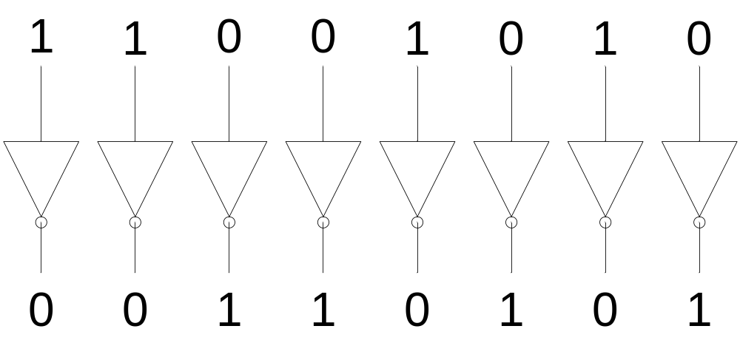
NOT Gate Applications
1’s Complement

Slide 17
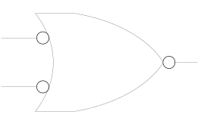
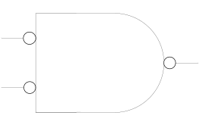
Alternate Representations

Slide 18
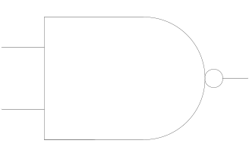
NAND Gate
1 output
2 inputs
3 inputs
4 inputs
Multiple inputs

Slide 19
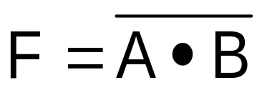
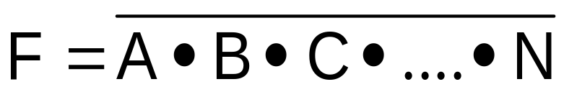
NAND Gate function
NOT-AND function
Input |  | Output
A | B | F
0 | 0 | 1
0 | 1 | 1
1 | 0 | 1
1 | 1 | 0

Slide 20
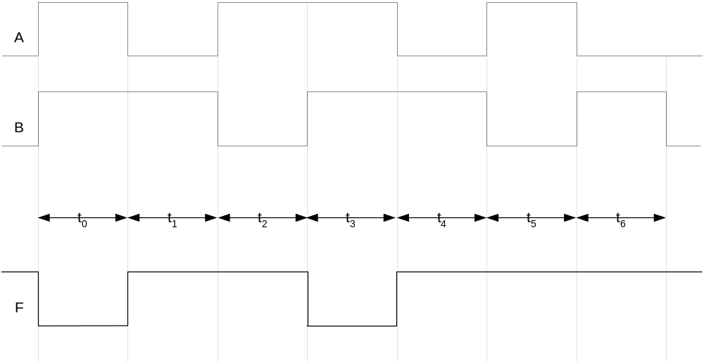
NAND Gate Timing Diagram

Slide 21
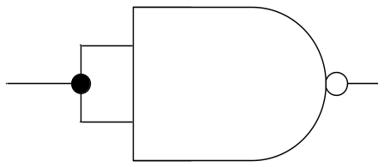
NAND Universal Gate
Input |  | Output
A | B | F
0 | 0 | 1
0 | 1 | 1
1 | 0 | 1
1 | 1 | 0

Slide 22
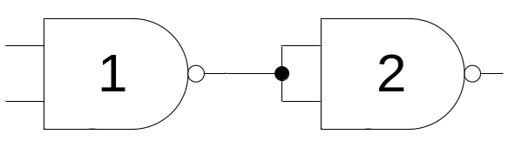
NAND Universal Gate
Input |  | Output | Output
A | B | F1 | F
0 | 0 | 1 | 0
0 | 1 | 1 | 0
1 | 0 | 1 | 0
1 | 1 | 0 | 1

Slide 23
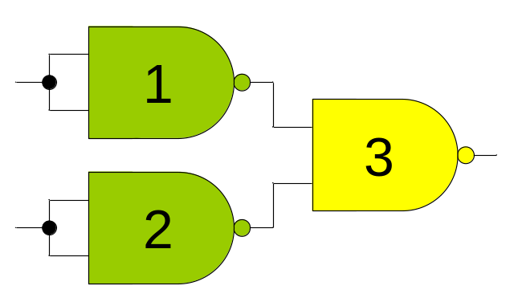
NAND Universal Gate
Input |  | Output
A | B | F
0 | 0 | 0
0 | 1 | 1
1 | 0 | 1
1 | 1 | 1

Slide 24
Recap
Boolean Logic
Boolean variables and logical operations
Logic Gates Basic Building Blocks
Symbol
Performs unique function
Represented by a function/truth table
Function expression
Timing Diagram

Slide 25

Recap
AND Gate F=A.B
OR Gate F=A+B
NOT Gate
AND Gate enables/disables device
OR Gate car door alarm system
NOT Gate 1’s complement

Slide 26

Recap
Alternate Symbolic representations
NAND Gate
NOT-AND operation
Universal NAND Gate

Slide 27
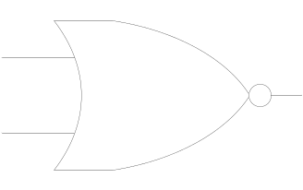
NOR Gate
1 output
2 inputs
3 inputs
4 inputs
Multiple inputs

Slide 28
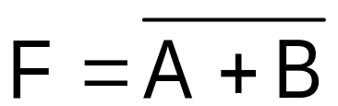
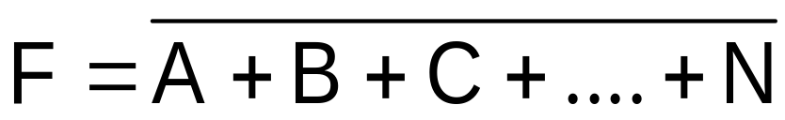
NOR Gate function
NOT-OR function
Input |  | Output
A | B | F
0 | 0 | 1
0 | 1 | 0
1 | 0 | 0
1 | 1 | 0

Slide 29
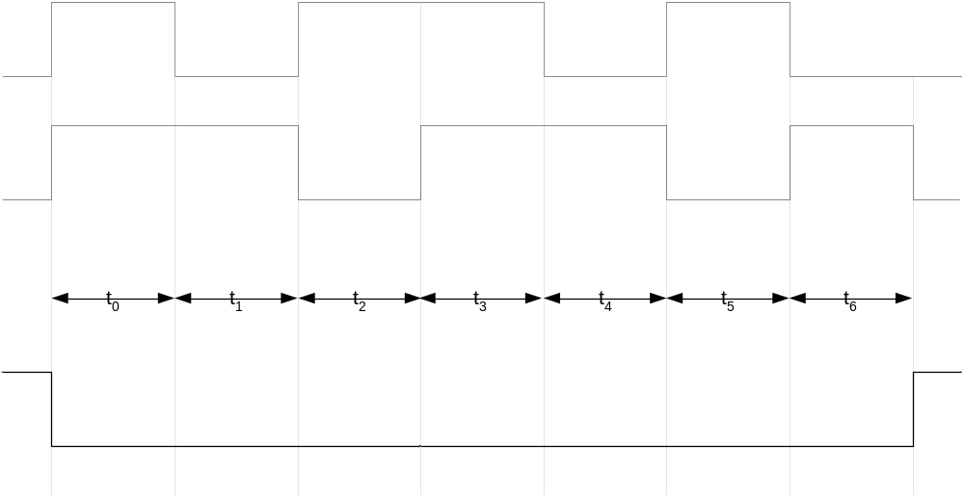
NOR Gate Timing Diagram

Slide 30
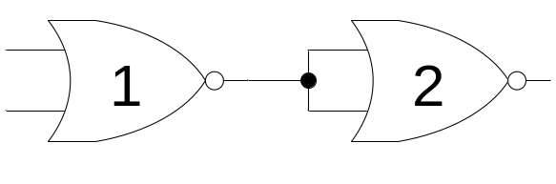
NOR Universal Gate
Input |  | Output
A | B | F
0 | 0 | 0
0 | 1 | 1
1 | 0 | 1
1 | 1 | 1

Slide 31
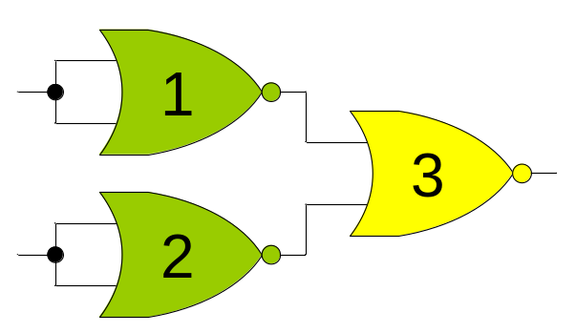
NOR Universal Gate

Slide 32
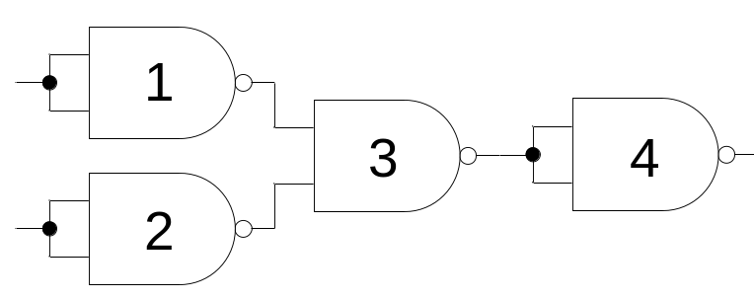
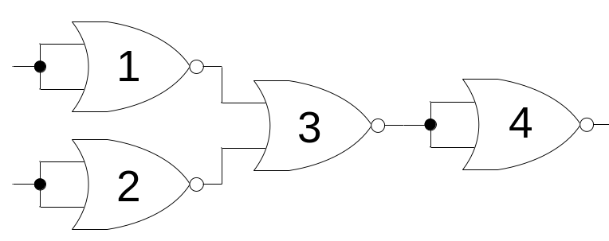
NAND-NOR Universal Gate

Slide 33
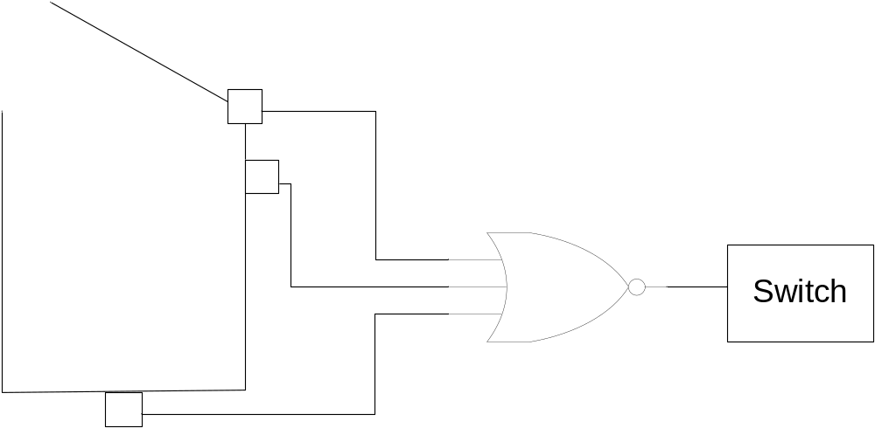
NOR Gate Applications
Washing Machine Controller
Notes:
Three sensors check for washing machine lid open, washing tub filled to minimum level and weight of cloths and water in the tub.
If the lid is open or the water is below the minimum level or the washing machine has been overloaded the appropriate sensor sets its output to 1. The NOR gate output is set to 0 switching off the washing machine.

Slide 34
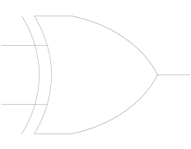
XOR Gate
1 output
2 inputs
Multiple inputs

Slide 35

XOR Gate function
Input |  | Output
A | B | F
0 | 0 | 0
0 | 1 | 1
1 | 0 | 1
1 | 1 | 0

Slide 36
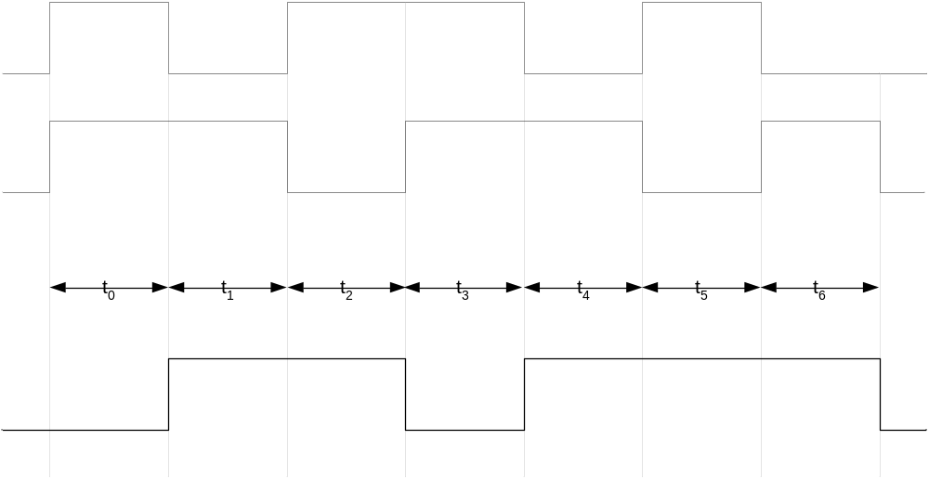
XOR Gate Timing Diagram

Slide 37
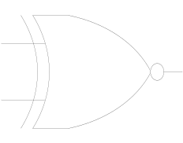
XNOR Gate
1 output
2 inputs
Multiple inputs

Slide 38
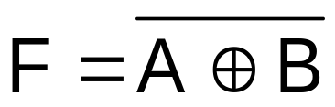
XNOR Gate function
Input |  | Output
A | B | F
0 | 0 | 1
0 | 1 | 0
1 | 0 | 0
1 | 1 | 1

Slide 39
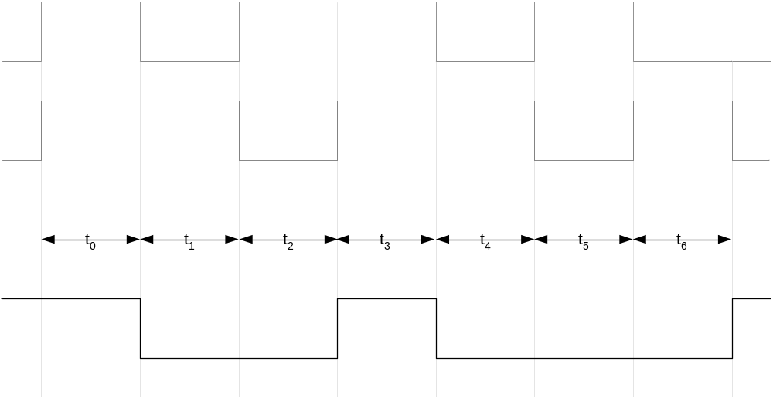
XNOR Gate Timing Diagram

Slide 40
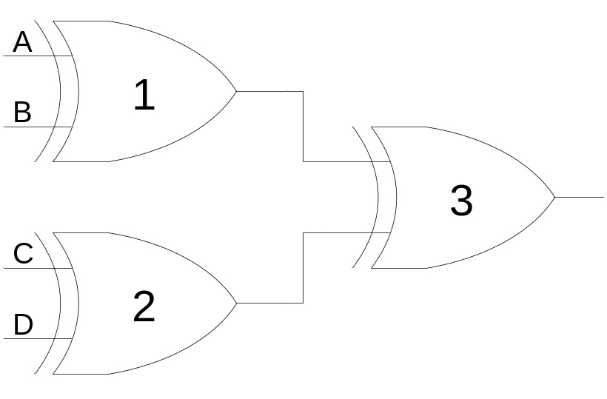
XOR Gate Applications
Detecting odd number of 1’s
Notes:
Consider the three XOR gate logic circuit which is used to detect odd number of 1’s in a 4-bit binary input combination
Consider the 4-bit binary number 0000 applied at the inputs A, B, C and D respectively of XOR gates 1 and 2.
The output of XOR Gates 1 and 2 is 0 and 0. The output of XOR gate 3 is also zero.
Consider the binary number 0011 applied at the inputs A, B, C and D respectively. The output of XOR gate 1 with inputs 00 is 0. The output of XOR gate 2 with inputs 11 is 0. The output of gate 3 is 0. Thus the output indicates that the binary number 0011 does not have odd number of 1’s
Consider the binary number 1011 applied at the inputs A, B, C and D respectively. The output of XOR gate 1 with inputs 10 is 1. The output of XOR gate 2 with inputs 11 is 0. The output of gate 3 is 1. Thus the output indicates that the binary number 1011 has odd number of 1’s

Slide 41

XNOR Gate Applications
Detecting even number of 1’s
Notes:
Consider the two XOR and a single XNOR gate based logic circuit used to detect even number of 1’s in a 4-bit binary input combination
Consider the 4-bit binary number 0000 applied at the inputs A, B, C and D respectively of XOR gates 1 and 2.
The output of XOR Gates 1 and 2 is 0 and 0. The output of XNOR gate 3 is a 1.
Consider the binary number 0011 applied at the inputs A, B, C and D respectively. The output of XOR gate 1 with inputs 00 is 1. The output of XOR gate 2 with inputs 11 is 1. The output of XNOR gate 3 is also a 1. Thus the output indicates that the binary number 0011 has even number of 1’s
Consider the binary number 1011 applied at the inputs A, B, C and D respectively. The output of XOR gate 1 with inputs 10 is 1. The output of XOR gate 2 with inputs 11 is 0. The output of XNOR gate 3 is 0 because of dissimilar inputs. Thus the output indicates that the binary number 1011 does not have even number of 1’s

